Slide 1



Degradation of Trace Organic Compounds via Advanced Oxidation Processes
Carlos Weiler
Mentor: Dr. Saez
Fellow researchers: Violeta Martinez, Natalia Rojas, Kenneth Castella, Ben Barnett
4/3/2020
Arizona Nasa Space Grant Symposium

Slide 2

The Santa Cruz River
The Santa Cruz has been revitalized by wastewater effluent
Two waste water treatment facilities discharge into the river
Rigorous cleaning process

Slide 3
However…Trace Organic Compounds
Even with such a process there are still TrOCs
Examples:
Carbamezapine
Testosterone
Iohexol
The long lasting effects of TrOCs are largely unknown
Neutralization of TrOCs are still sought after

Slide 4
Methods of Neutralization
Numerous methods that are being researched
  Membrane Distillation
  Bioreactors
  UV/H₂O₂
Solar neutralization
Mechanisms
  Direct Photolysis
  Indirect Photolysis
Indirect Photolysis
  Light
  Sensitizer/Photosensitizer
  Oxygen
  TrOCs

Slide 5

Mechanism Under Study
S
S*
TrOCs
¹O₂
O₂
Products

Slide 6
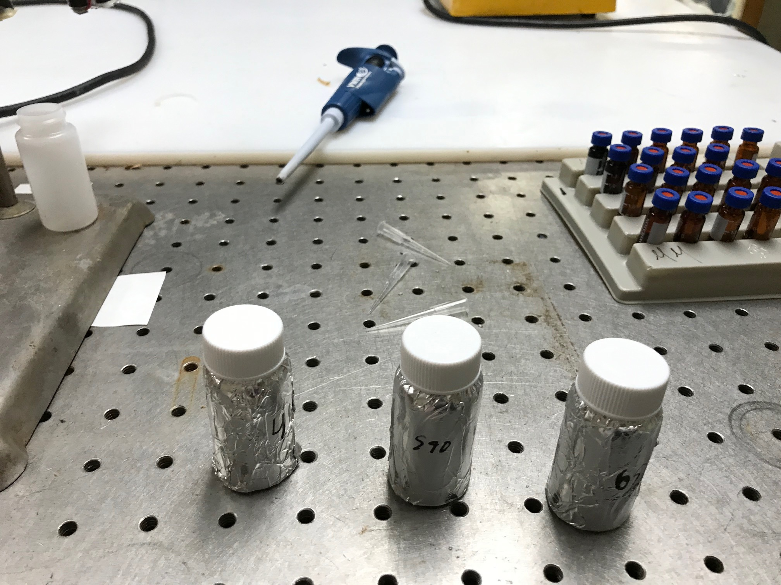
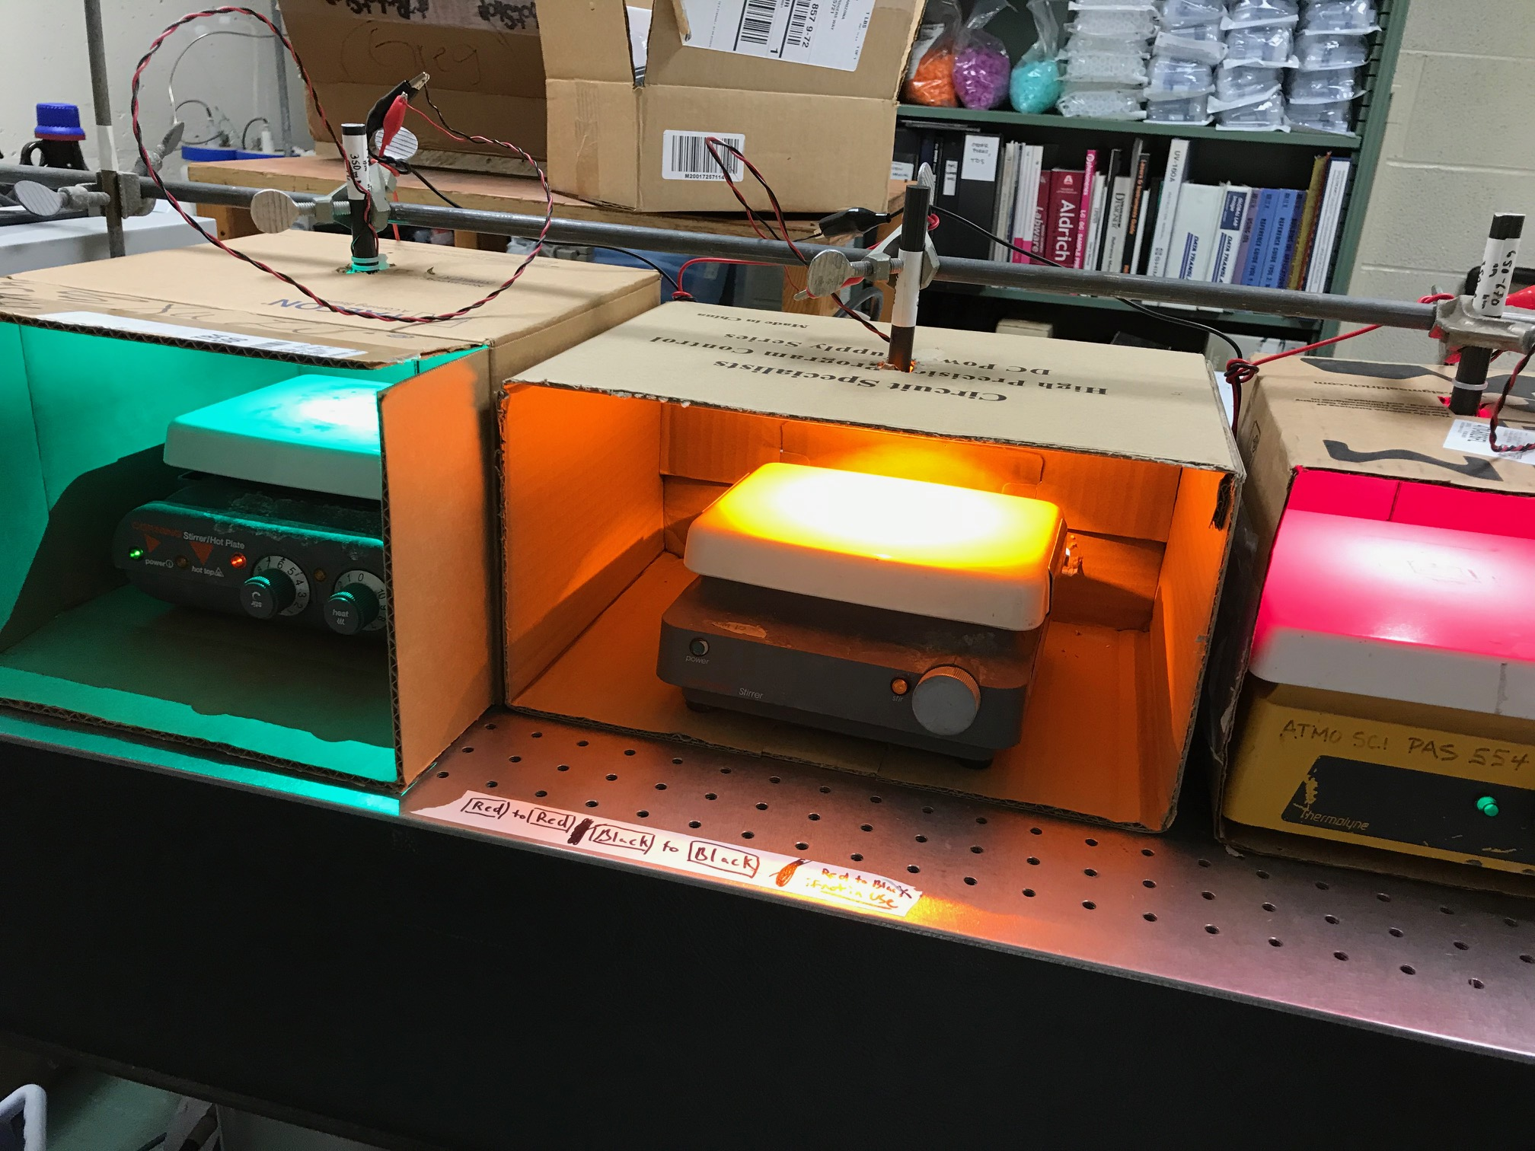
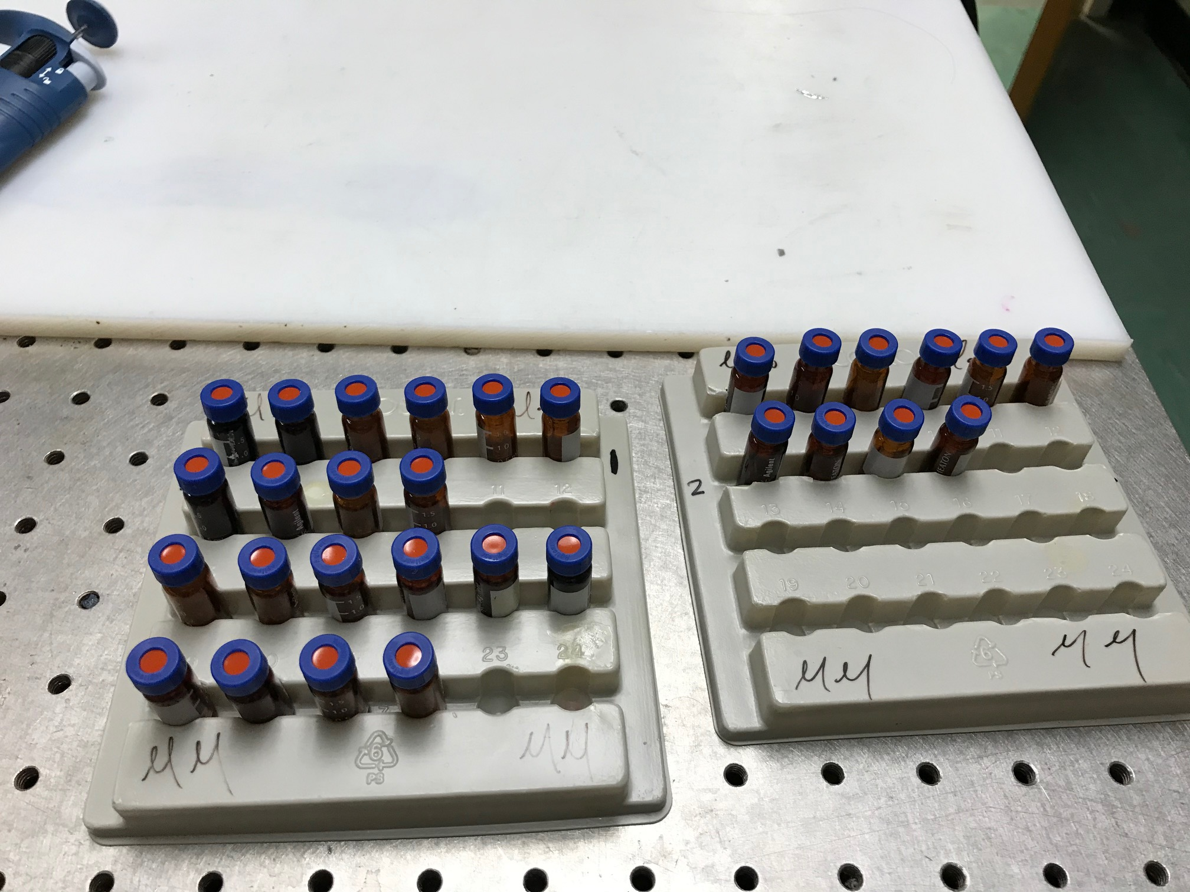
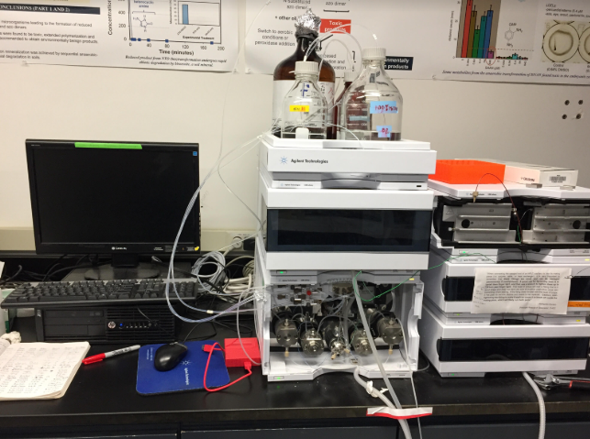
Area of Focus
Determine whether or not wavelength is important to the mechanism
Experimental Setup
  Batch reactor with wastewater concentrate
  Spiked with FFA
  Light Emitting Diodes (LEDs)
  Concentrations measured using HPLC

Slide 7
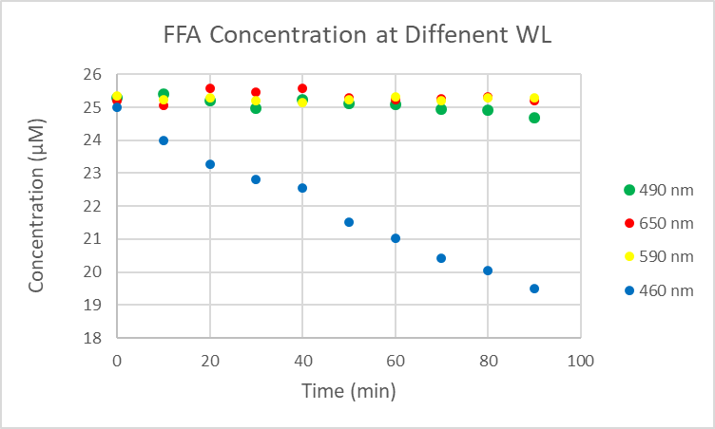
Results
The higher wavelengths, lower energy, LEDs do not show degradation of the target TrOCs
Wavelengths closer to Ultraviolet show a greater degradation of TrOCs

Slide 8
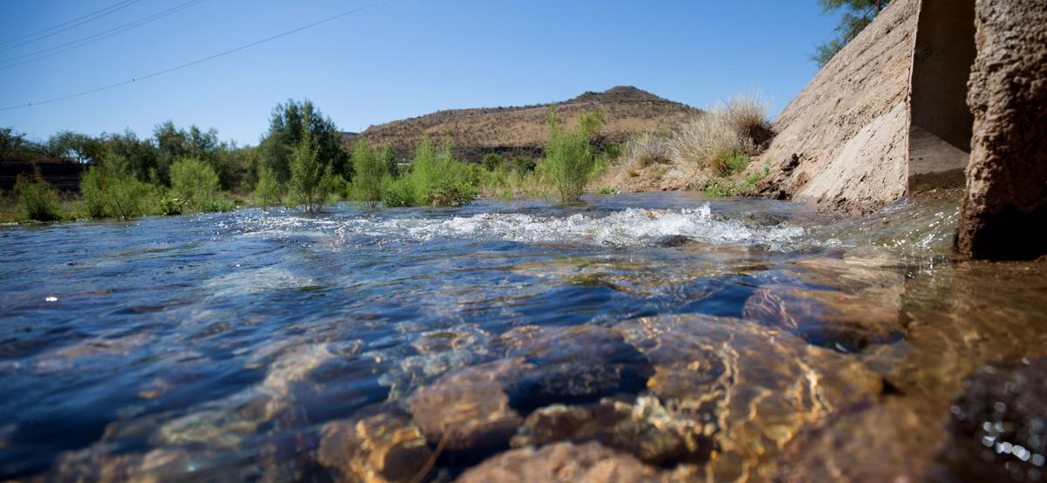
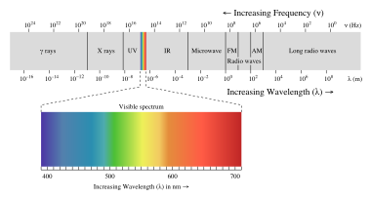
Conclusion
Higher energy wavelengths show a greater degradation of the TrOC
  Does not prove that the mechanism understudy is the only path way of degradation
Further experiments still need to be done
  More specific wavelengths need to be tested
  Light intensities of LEDs
Test other TrOCs with the same conditions as FFA

Slide 9
Acknowledgements
I would like to give thanks to the entire research group! Without them my experience would have not been as great as it was!
I would like to thank the NASA Space grant for giving me this opportunity!
I would like to thank Michelle Coe for organizing such a great program!
Lastly I would like to thank Dr. Saez!

Slide 10
THANK YOU!
Questions?

